Slide 1

COMMUNICATION MAPPING
Susan M. Bashinski
(for the Kansas State
Deaf-Blind Project)

Slide 2
COMMUNICATION MAP
Provides visual, “at-a-glance” profile of a learner’s current communication skills
and
Overview of an IFSP / IEP team’s short-term and long-range plans for a learner’s communication program

Slide 3
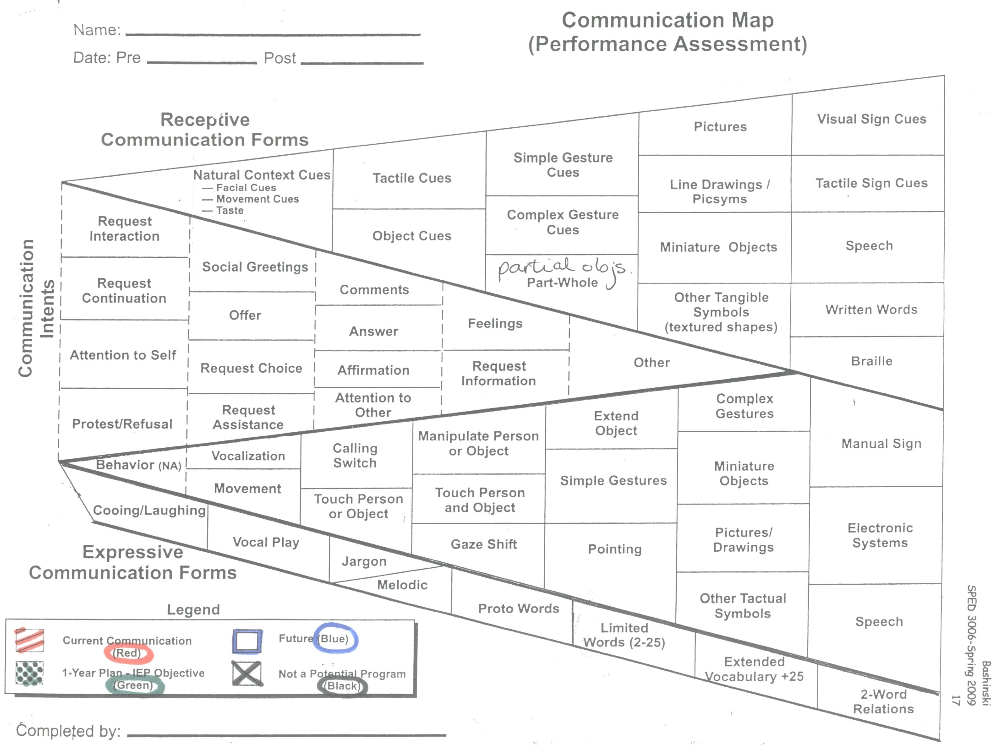
Communication Map (1 of 8)

Slide 4
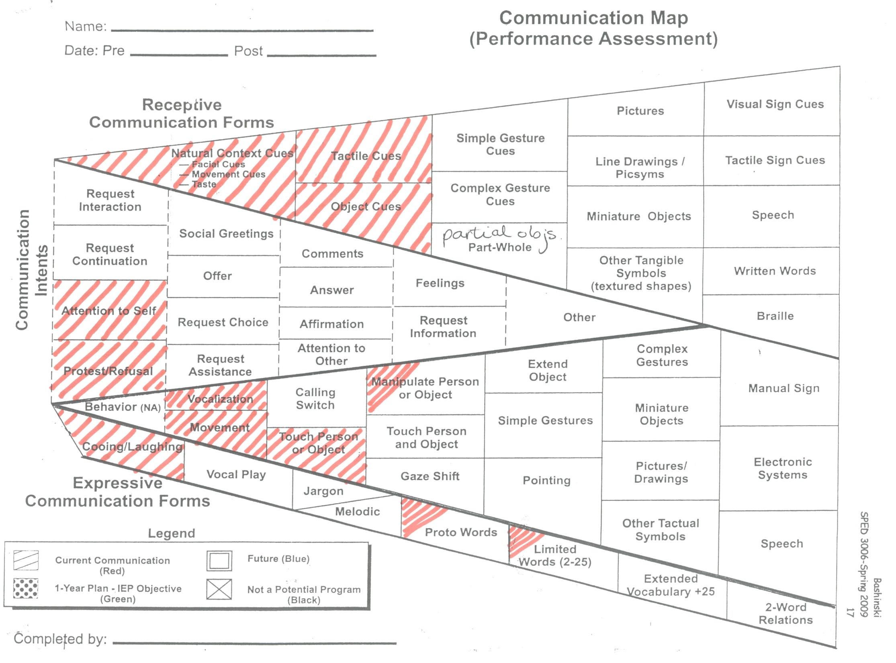
Communication Map (2 of 8)

Slide 5
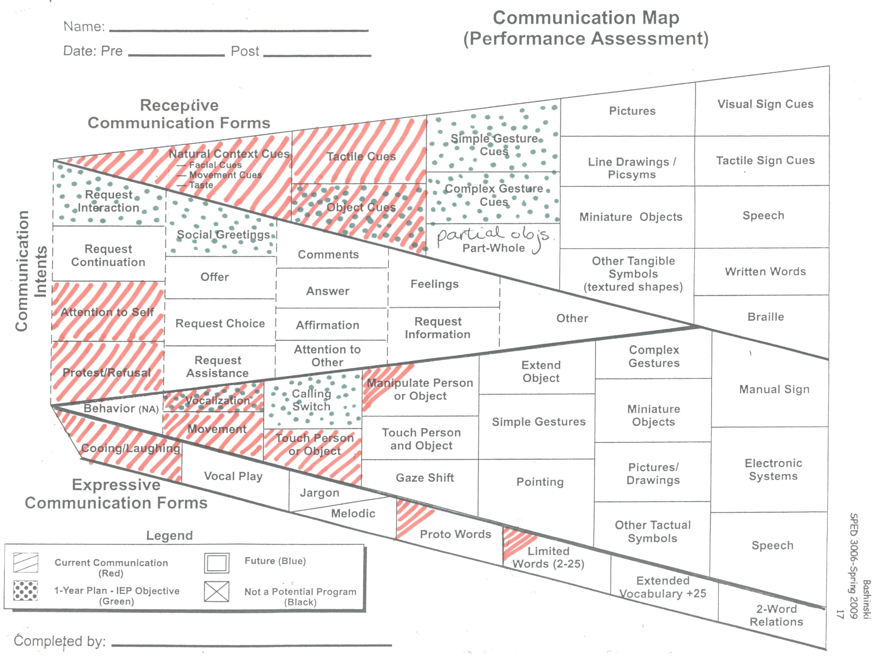
Communication Map (3 of 8)

Slide 6
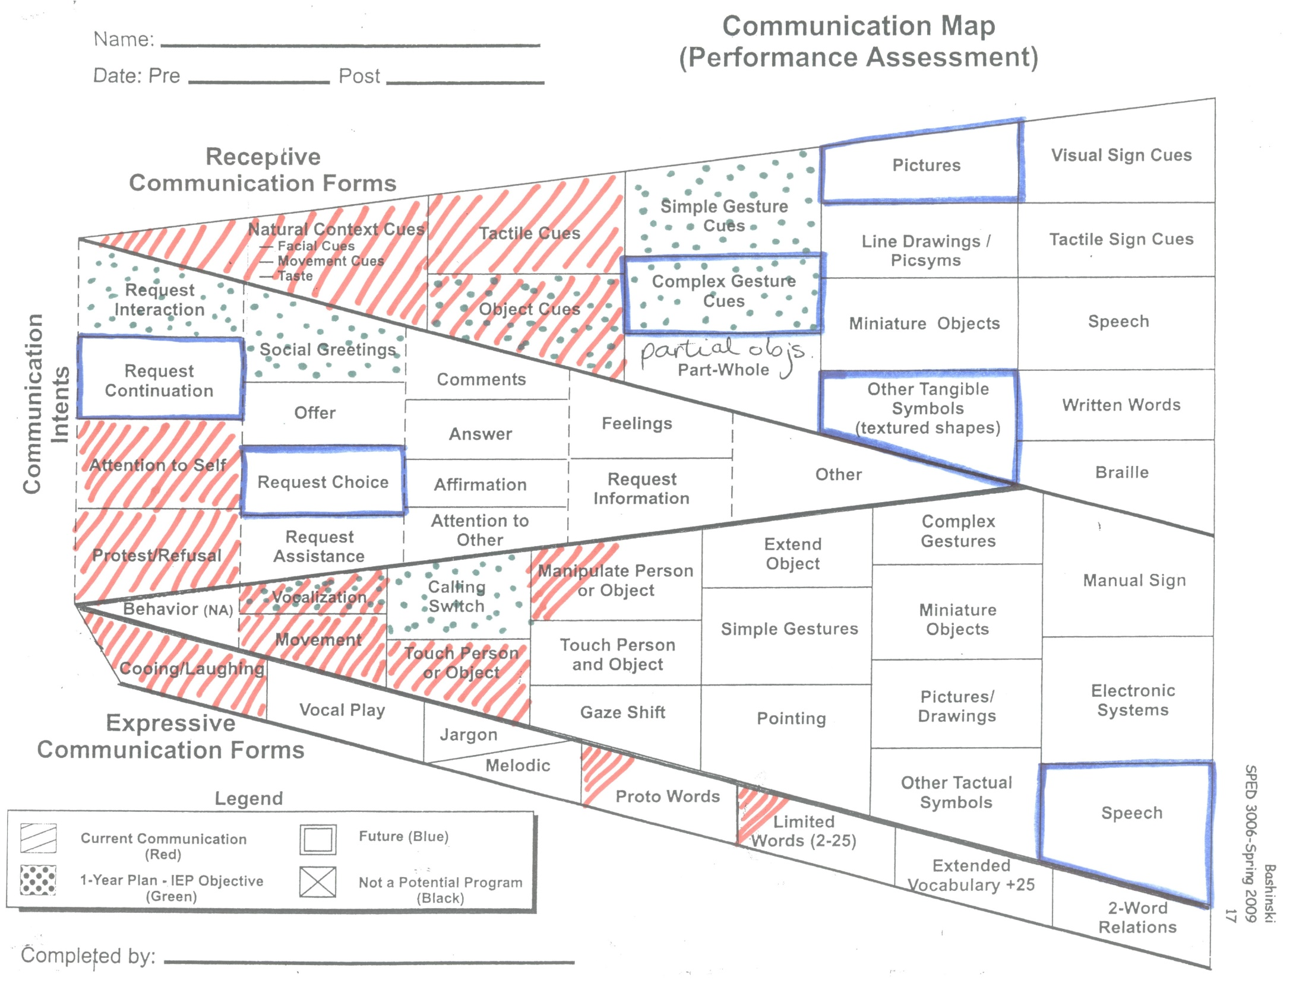
Communication Map (4 of 8)

Slide 7
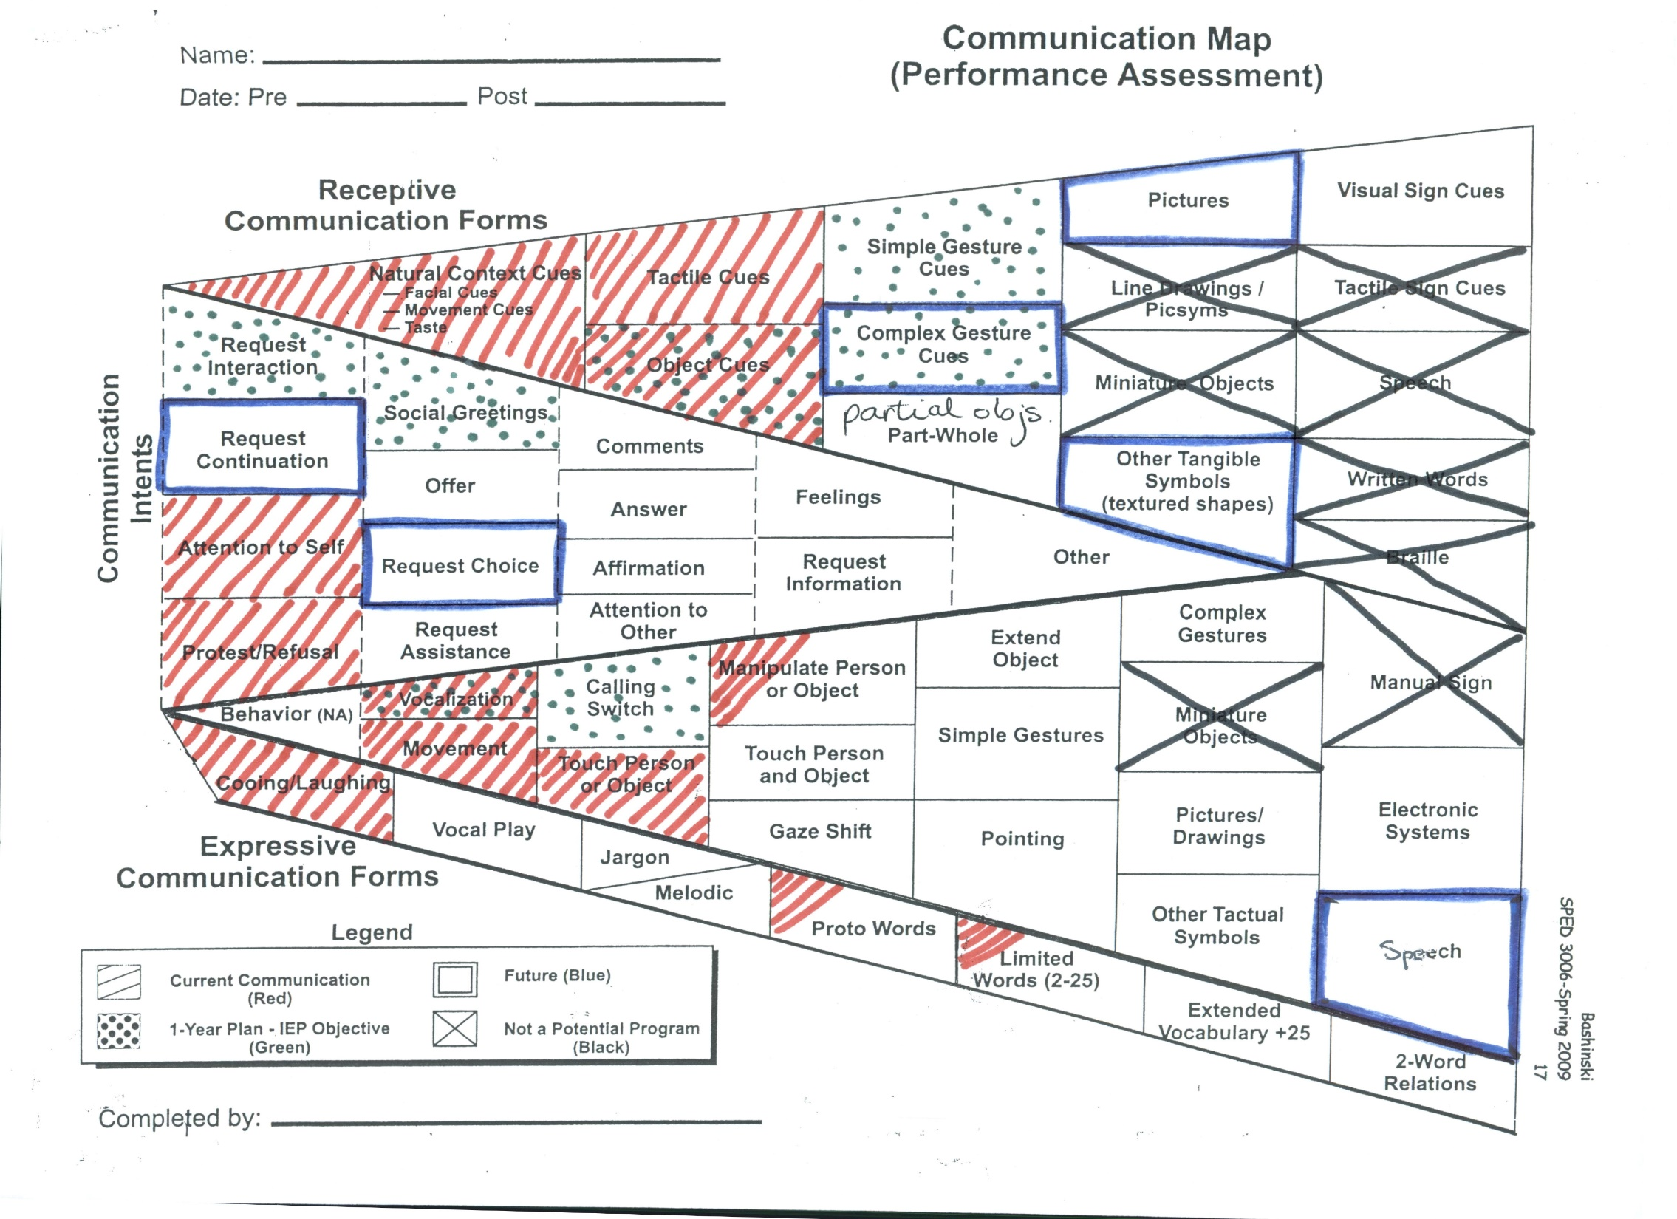
Communication Map (5 of 8)

Slide 8
Key Components of Symbolic Expression (Werner & Kaplan, 1988)
1. Addressor (message sender) -
child who experiences deaf-blindness
2. Addressee (message receiver) -
communication partner
3. Referent - object to be represented
4. Representation

Slide 9
Key Components of Symbolic Expression (cont.) (Werner & Kaplan, 1988)
Representation:
Symbols are abstract representations
Symbolic communication – using ABSTRACT representations (symbols) with DISTANCING (separation in TIME and SPACE between the referent and representation)

Slide 10
CONTINUUM OF SYMBOLIZATION DEVELOPMENT
NONSYMBOLIC | TRANSITIONAL (CONCRETE SYMBOLIC) | SYMBOLIC (ABSTRACT SYMBOLIC)
Idiosyncratic gestures / vocalizations | Conventional gestures / vocalizations | Conventional verbalizations
May demonstrate little overt behavior | Three-dimensional objects | Traditional orthographies
Partner is responsible for communicative interaction | Partner shares responsibility for communicative interaction | Learner is responsible for own communication

Slide 11
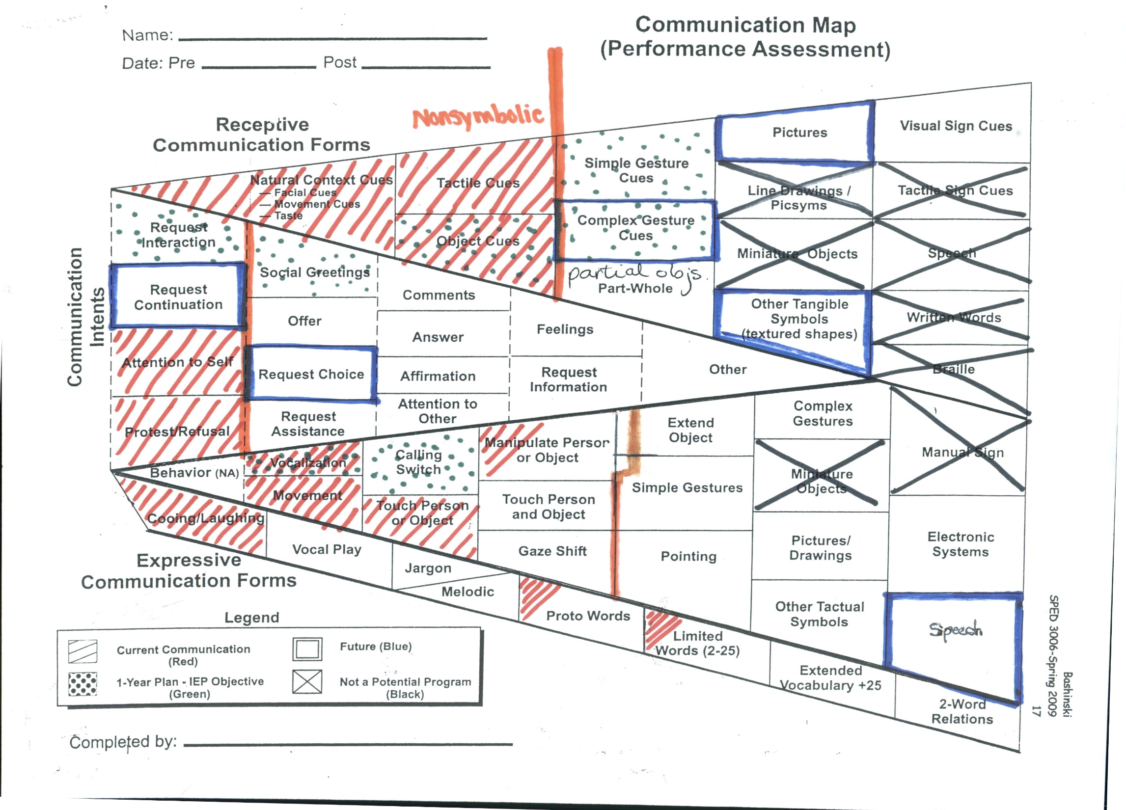
Communication Map (6 of 8)

Slide 12
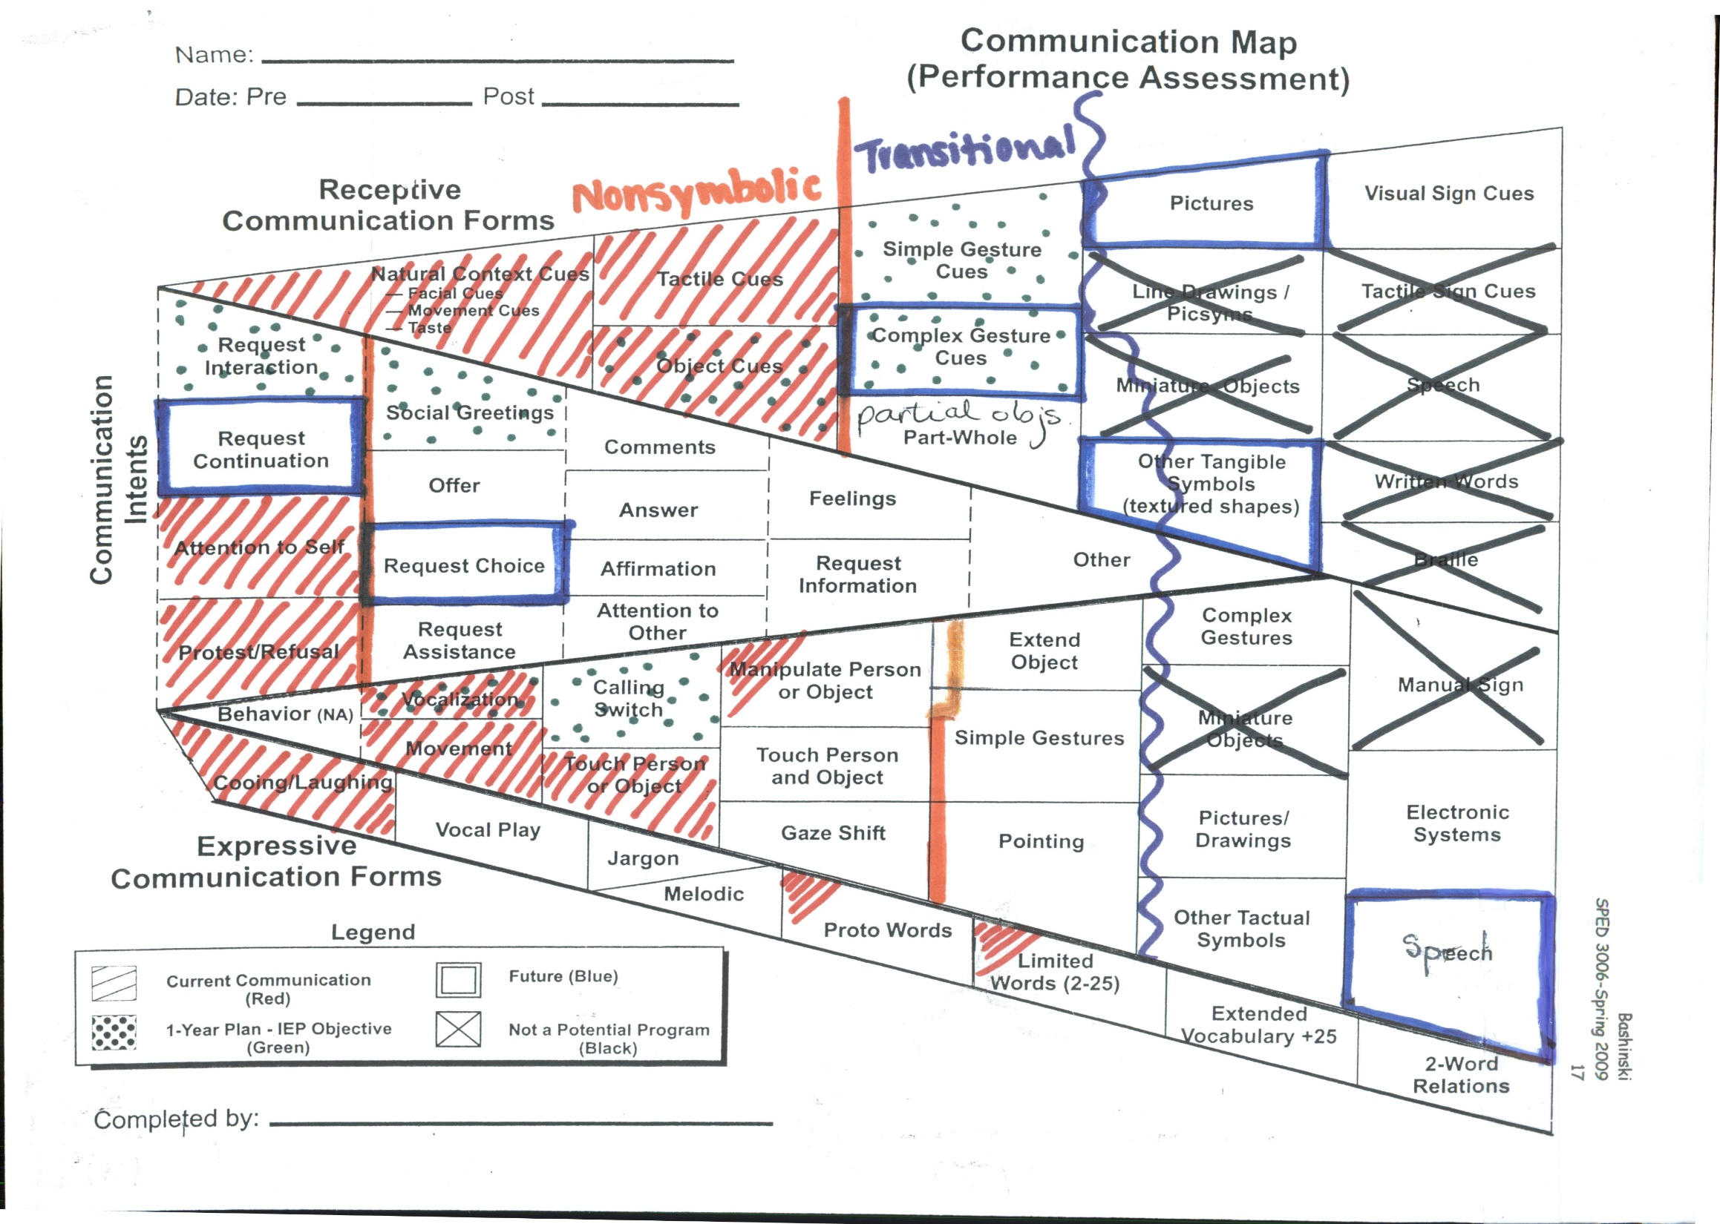
Communication Map (7 of 8)

Slide 13
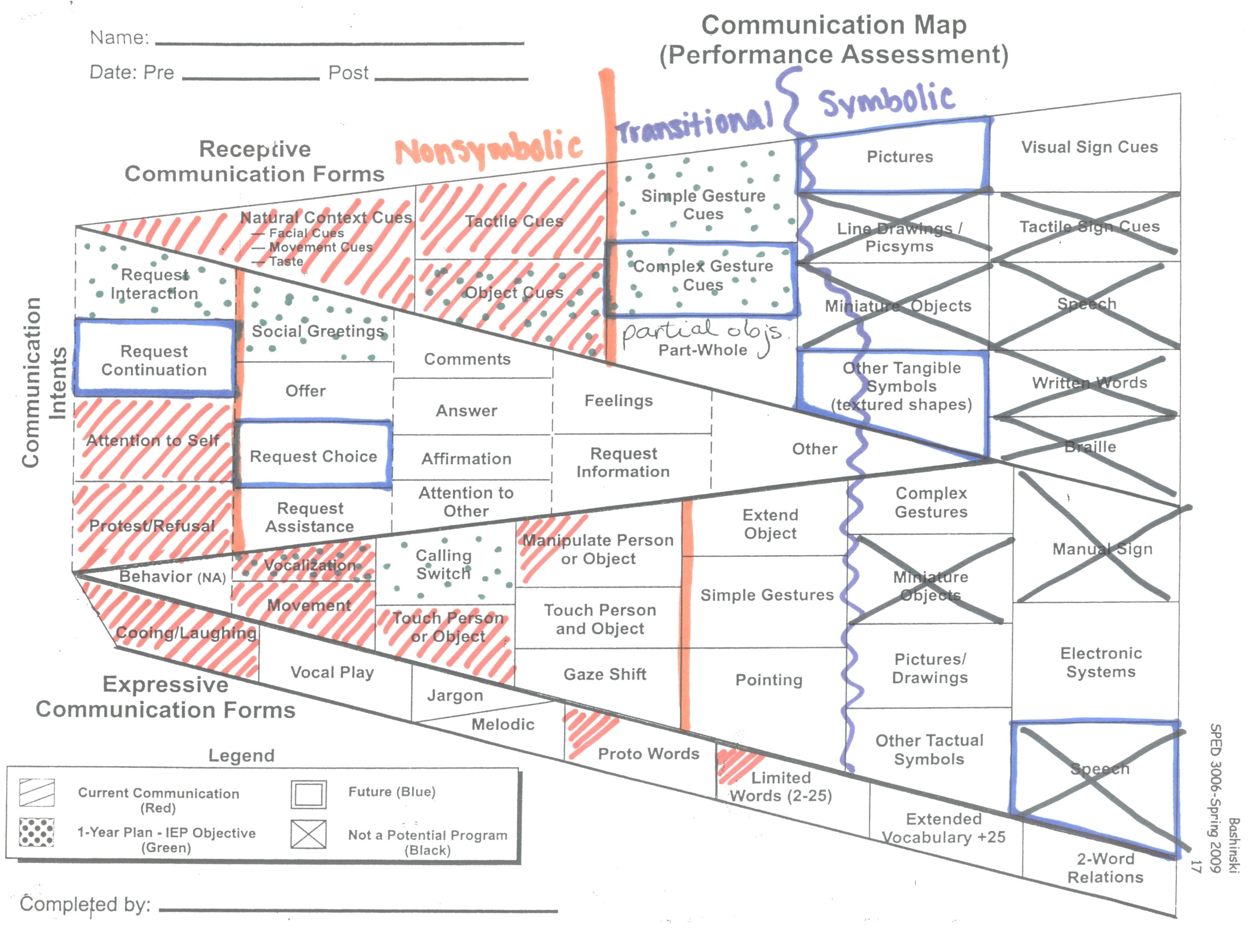
Communication Map (8 of 8)

Slide 14
Resources re: SYMBOLIZATION
If you’re interested in learning more about the development of symbolization ability, please see separate webinar recording:
The Symbolization Continuum
provided by the Kansas State Deaf-Blind Project.

Slide 15
Resources re: SYMBOLIZATION (cont.)
www.nationaldb.org
“Selected topics”
“Communication - The Path to Symbolism”
Werner, H. & Kaplan, B. (1988). On development changes in the symbolic process. In M. Franklin & S. Barten (Eds.). Child language: A reader (pp. 7-9). New York: Oxford University Press.

Slide 16
Credits
Developed by the Distance Mentorship Project at the University of Kansas
Content by:
Susan M. Bashinski
Megan Cote
Rebecca Obold-Geary
2011-2013

