Slide 1

INTRODUCTION TO HEARING LOSS
Susan M. Bashinski
(for the Kansas State Deaf-Blind Project)

Slide 2
TYPES OF HEARING LOSS
TYPES include:
Conductive hearing loss
Sensori-neural hearing loss
Processing problems (CAPD)
Combination problems

Slide 3
CONDUCTIVE HEARING LOSS
Occurs when sound cannot pass through the outer ear to the inner ear effectively
Development of the auditory canal
Blockage, in external ear, by ear wax, fluid, or a tumor
Otitis media (middle ear infection) is a common cause, as fluid in the middle ear prevents reliable conduction of sound

Slide 4
CONDUCTIVE HEARING LOSS (CONT.)
Attenuates (i.e., “weakens”) sound, because the ear drum does not move “normally” when the previously listed conditions exist

Slide 5
SENSORI-NEURAL HEARING LOSS (1 OF 3)
caused by poor development of, or damage to, the inner ear (cochlea) and / or to the auditory nerve
chronic middle ear infections may cause damage to the ear and result in a sensori-neural hearing loss

Slide 6
SENSORI-NEURAL HEARING LOSS (2 OF 3)
may also occur due to abnormalities in the auditory cortex or brainstem—which results in a condition referred to as “auditory neuropathy spectrum disorder” or “auditory dys-synchrony”
Notes:
Approximately 10% of SN losses are believed to be AN

Slide 7
SENSORI-NEURAL HEARING LOSS (3 OF 3)
attenuates (i.e., “weakens”) sound
distorts perception of sound
a sensori-neural hearing loss is permanent

Slide 8
MIXED HEARING LOSS
Term used to describe a loss that is both conductive and sensori-neural

Slide 9
UNILATERAL OR BILATERAL HEARING LOSS
Hearing loss is, also, categorized as
Unilateral or Bilateral
Unilateral: “normal” hearing in one ear and a hearing loss, of any degree, in the other
Bilateral: the hearing loss occurs in both ears (though intensity and frequency may be same or different

Slide 10
CENTRAL AUDITORY PROCESSING DISORDER (CAPD)
Limited and / or inconsistent “hearing,” due to a problem in the cortex or auditory pathways in the brain not properly processing auditory info.
The anatomy of the ear (outer, middle, and inner), is not impaired

Slide 11
SIGNS OF CAPD
1. sound localization
2. auditory discrimination
3. ability to process quick sound sequences (i.e., patterns)
Notes:
ASHA 1996

Slide 12
SIGNS OF CAPD (CONT.)
4. weakening of auditory skills in conditions w/competing speech or background noise
5. weakening of auditory skills in conditions w/ degraded signals (e.g., poor telephone connection)
Notes:
ASHA 1996

Slide 13
COMBINATION PROBLEMS
For example a child can have both a conductive hearing loss and CAPD

Slide 14
DIMENSIONS
DIMENSIONS of hearing loss include:
intensity (loudness) loss
frequency (pitch) loss

Slide 15
AUDIOGRAM
An audiogram is a graph that describes a learner’s hearing sensitivity, in terms of sound intensity and frequency.

Slide 16
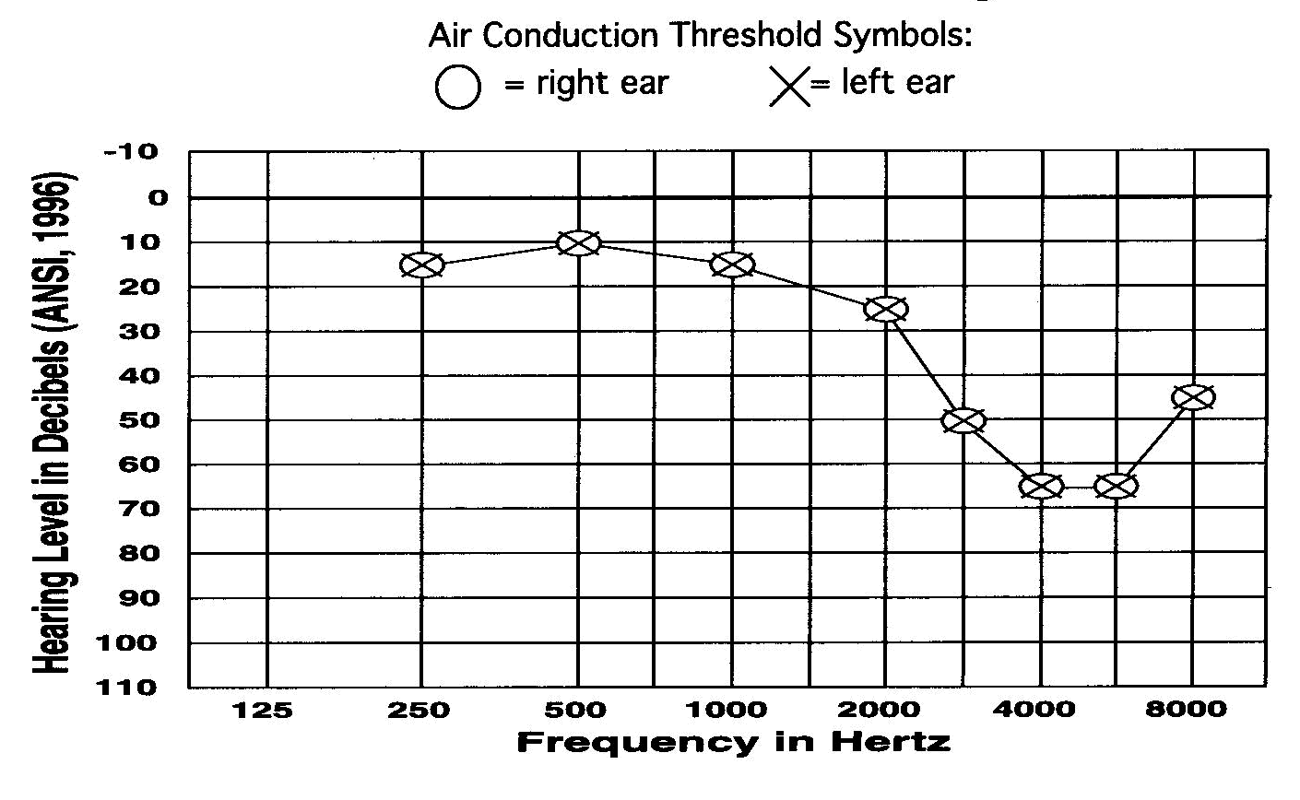
AUDIOGRAM EXAMPLE
Example of an audiogram:
Notes:
YOU HEAR WHAT IS UNDER THE LINE ON AN AUDIOGRAM

Slide 17
INTENSITY (LOUDNESS) LOSS
The DEGREES of intensity loss include:
mild (26 – 40 dB or louder)
mild-to-moderate (41 – 55 dB or louder)
moderate (56 -70 dB or louder)
severe (71 - 90 dB or louder)
profound (91 dB or louder)
Notes:
NOT absolute “levels”

Slide 18
FREQUENCY (PITCH) LOSS
Hearing ability is indicated by the point of intensity At which an individual can just barely hear a sound at a specific frequency.

Slide 19
HEARING IMPAIRMENT
Hearing is also affected by:
the presence of background noise (in the environment) “sound-to-noise ratio”
the distance (of the learner) from the source of the sound
Notes:
#2 – because the HUMAN VOICE has limited power. The intensity of speech decreases with distance from the source of the sound
AMBIENT SOUND SOURCES: duct noise, light fixtures, electrical, ventilation systems, diffusers, computers, exterior walls (outside noise), student generated noise

Slide 20
RESOURCES
Sensory Perspectives
by: SKI-HI Institute
Utah State University

Slide 21
Credits
Developed by the Distance Mentorship Project at the University of Kansas
Content by:
Susan M. Bashinski
Megan Cote
Rebecca Obold-Geary
2011-2013

